Slide 1
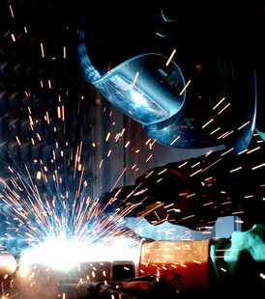
GMAW

Slide 2
Gas Metal Arc Welding (GMAW)
Gas Metal Arc Welding (GMAW), is an arc welding process which produces the coalescence of metals by heating them with an arc between a continuously fed filler metal electrode and the work. The process uses shielding from an externally supplied gas to protect the molten weld pool. The application of GMAW generally requires DC+ (reverse) polarity to the electrode.
The alloy material range for GMAW includes: carbon steel, stainless steel, aluminum, magnesium, copper, nickel, silicon bronze and tubular metal-cored surfacing alloys. The GMAW process lends itself to semiautomatic, robotic automation and hard automation welding applications.

Slide 3
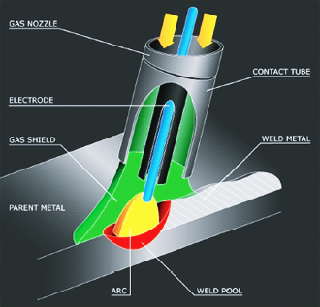

Slide 4
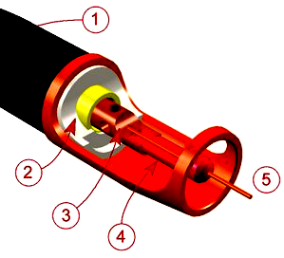
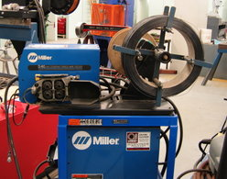
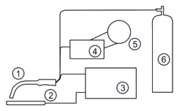
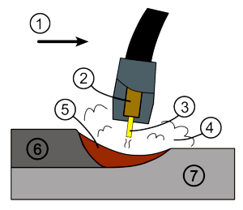
(1) Torch handle, (2) Molded phenolic dielectric and threaded metal nut insert (yellow), (3) Shielding gas nozzle,
(4) Contact tip, (5) Nozzle output face
GMAW wire feed unit
(1) Welding torch, (2) Workpiece, (3) Power source, (4) Wire feed unit, (5) Electrode source, (6) Shielding gas supply
(1) Direction of travel, (2) Contact tube, (3) Electrode, (4) Shielding gas, (5) Molten weld metal, (6) Solidified weld metal, (7) Workpiece

Slide 5
Advantages of GMAW
The GMAW process enjoys widespread use because of its ability
to provide high quality welds, for a wide range of ferrous and Non –
ferrous alloys, at a low price. GMAW also has the following
advantages:
• The ability to join a wide range of material types and thicknesses.
• Simple equipment components are readily available and affordable.
GMAW has higher electrode efficiencies, usually between 93% and 98%, when compared to other welding processes.
• Higher welder efficiencies and operator factor, when compared to other open arc welding processes.

Slide 6
• GMAW is easily adapted for high-speed robotic, hard automation and semiautomatic welding applications.
• All-position welding capability.
• Excellent weld bead appearance.
• Lower hydrogen weld deposit — generally less than 5 mL/100 g of weld metal.
• Lower heat input when compared to other welding processes.
• A minimum of weld spatter and slag makes weld clean up fast and easy.
• Less welding fumes when compared to SMAW (Shielded Metal Arc Welding) and FCAW (Flux-Cored Arc Welding) processes.

Slide 7
Benefits of GMAW
• Generally, lower cost per length of weld metal deposited when compared to other open arc welding processes.
• Lower cost electrode.
• Less distortion with GMAW-P (Pulsed Spray Transfer Mode), GMAW-S (Short-Circuit Transfer Mode) and STT (Surface Tension Transfer).
• Handles poor fit-up with GMAW-S and STT modes.
• Reduced welding fume generation.
• Minimal post-weld cleanup.

Slide 8
Limitations of GMAW
• The lower heat input characteristic of the short-circuiting mode of metal transfer restricts its use to thin materials.
• The higher heat input axial spray transfer generally restricts its use to thicker base materials.
• The higher heat input mode of axial spray is restricted to flat or horizontal welding positions.
• The use of argon based shielding gas for axial spray and pulsed spray transfer modes is more expensive than 100% carbon dioxide (CO2).

Slide 9
Short circuit mode of metal transfer

Slide 10
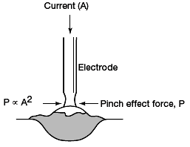
Advantages of Short-Circuiting Transfer
• All-position capability, including flat, horizontal, vertical-up, vertical-down and overhead.
• Handles poor fit-up extremely well, and is capable of root pass work on pipe applications.
• Lower heat input reduces weldment distortion.
• Higher operator appeal and ease of use.
• Higher electrode efficiencies, 93% or more.
Limitations of Short-Circuiting Transfer
• Restricted to sheet metal thickness range and open roots of groove joints on heavier sections of base material.
• Poor welding procedure control can result in incomplete fusion. Cold lap and cold shut are additional terms that serve to describe incomplete fusion defects.
• Poor procedure control can result in excessive spatter, and will increase weldment cleanup cost.
• To prevent the loss of shielding gas to the wind, welding outdoors may require the use of a windscreen(s).

Slide 11
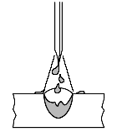
Globular Transfer
Advantages of Globular Transfer
• Uses inexpensive CO2 shielding gas, but is frequently used with argon/CO2 blends.
• Is capable of making welds at very high travel speeds.
• Inexpensive solid or metal-cored electrodes.
• Welding equipment is inexpensive.
Limitations of Globular Transfer:
• Higher spatter levels result in costly cleanup.
• Reduced operator appeal.
• Prone to cold lap or cold shut incomplete fusion defects, which results in costly repairs.
• Weld bead shape is convex, and welds exhibit poor wetting at the toes.
• High spatter level reduces electrode efficiency to a range of 87 – 93%.

Slide 12
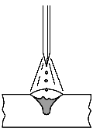
Axial Spray Transfer
Advantages of Axial Spray Transfer
• High deposition rates and High electrode efficiency of 98% or more.
• Employs a wide range of filler metal types in an equally wide range of electrode diameters.
• Excellent weld bead appearance.
• High operator appeal and ease of use.
• Requires little post weld cleanup.
• Absence of weld spatter and Excellent weld fusion.
• Lends itself to semiautomatic, robotic, and hard automation applications.
Limitations of Axial Spray Transfer
• Restricted to the flat and horizontal welding positions.
• Welding fume generation is higher.
• The higher-radiated heat and the generation of a very bright arc require extra welder and bystander protection.
• The use of axial spray transfer outdoors requires the use of a wind screens.
• The shielding used to support axial spray transfer costs more than 100% CO2.

Slide 13

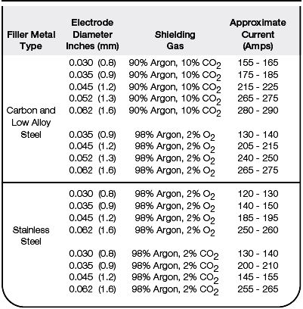

Slide 14
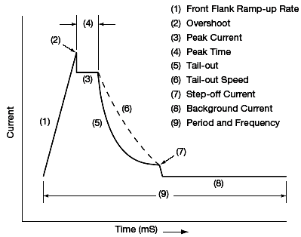
Pulsed Spray Transfer
Advantages of Pulsed Spray Transfer
• Absent or very low levels of spatter.
• More resistant to lack of fusion defects than other modes of GMAW metal transfer.
• Excellent weld bead appearance.
• High operator appeal.
• Offers an engineered solution for the control of weld fume generation.
• Reduced levels of heat induced distortion.
• Ability to weld out-of-position.
• Lower hydrogen deposit.
• Reduces the tendency for arc blow.
• Handles poor fit-up.
• When compared to FCAW, SMAW, and GMAW-S, pulsed spray transfer provides a low cost high-electrode efficiency of 98%.
• Lends itself to robotic and hard automation applications.
• Capable of arc travel speeds greater than 50 inches per minute (1.2 m/min.).

Slide 15
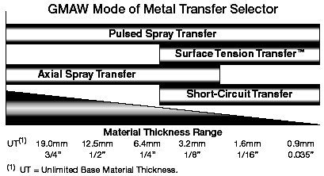
Limitations of Pulsed Spray
Transfer
• Equipment to support the process is more expensive than traditional systems.
• Blends of argon based shielding gas are more expensive than carbon dioxide.
• Higher arc energy requires the use of additional safety protection for welders and bystanders.
• Adds complexity to welding.
• Requires the use of windscreens outdoors.

Slide 16
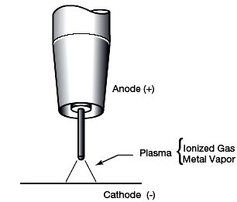
The behavior of the arc is influenced by:
• The type and diameter of the filler metal.
• The base metal conditions — clean or mill scale.
• The shielding gas.
• The welding parameters — voltage and current.
• The interaction of physical forces — gravity, surface tension, jet forces, and electromagnetic force.
Cross Section of a GMAW Arc

Slide 17
Shielding Gases for GMAW
Selection criteria of the correct shielding gas
• Alloy of wire electrode.
• Desired mechanical properties of the deposited weld metal.
• Material thickness and joint design, • Material condition – the presence of mill scale, corrosion, resistant coatings, or oil.
• The mode of GMAW metal transfer, • The welding position.
• Fit-up conditions, • Desired penetration profile.
• Desired final weld bead appearance, • Cost

Slide 18
Inert Shielding Gases
Helium is commonly added to the gas mix for stainless and aluminum applications. Its thermal conductivity is very high, resulting in the broad but less deep penetration profile. When in use, arc stability will require additions of arc voltage. Helium additions to argon are effective in reducing the dilution of base material in corrosion resistant applications. Helium / argon blends are commonly used for welding aluminum greater than 25 mm thick.

Slide 19
Inert Shielding Gases
Argon is the most commonly used inert gas. Compared to helium its thermal conductivity Is low. Its energy required to give up an electron, ionization energy, is low, and this results in the finger-like penetration profile associated with its use. Argon supports axial spray transfer. Nickel, copper, aluminum, titanium, and magnesium alloyed base materials use 100% argon shielding. Argon, because of its lower ionization energy, Assists with arc starting. It is the main component gas used in binary (two-part) or ternary (three part) mixes for GMAW welding. It also Increases the molten droplet transfer rate.

Slide 20
Reactive Shielding Gases
Oxygen, hydrogen, nitrogen, and carbon dioxide (CO2) are reactive gases. Reactive gases combine chemically with the weld pool to produce a desirable effect.

Slide 21
Carbon Dioxide (CO2)
Carbon Dioxide (CO2) is inert at room temperature. In the presence of the arc plasma and the molten weld puddle it is reactive. In the high energy of the arc plasma the CO2 Molecule breaks apart in a process known as dissociation. In this process, free carbon, carbon monoxide, and oxygen Release from the CO2 molecule. This occurs at the DC+ anode region of the arc. At the DC- cathode region, which is invariably the work piece for GMAW, the released elements of the CO2 molecule undergo the process of recombination. During recombination higher energy levels exist and are responsible for the deep and broad penetration profile that characterizes the use of carbon dioxide.

Slide 22
Oxygen (O2)
Oxygen (O2) is an oxidizer, that reacts with components in the molten puddle to form oxides. In small additions (1-5%), with a balance of argon, it provides good arc stability and excellent weld bead appearance. The use of deoxidizers within the chemistry of filler alloys compensate for the oxidizing effect of oxygen. Silicon and manganese combine with oxygen to form oxides. The oxides float to the surface of the weld bead to form small islands, and they are more abundant under CO2 shielding than with blends of argon and oxygen gas.

Slide 23
Hydrogen (H2)
Hydrogen (H2) in small percentages (1-5%), is added to argon
for shielding stainless steel and nickel alloys. Its higher thermal
conductivity produces a fluid puddle, which promotes improved
toe wetting and permits the use of faster travel speeds.

Slide 24
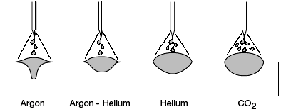
Binary Shielding Gas Blends
Two-part shielding gas blends are the most common and they
are typically made up of either argon + helium, argon + CO2,
or argon + oxygen.
Bead contour and penetration patterns for various shielding gases

Slide 25
Argon + Helium
Argon/helium binary blends are useful for welding nickel based
alloys and aluminum. The mode of metal transfer used is either
axial spray transfer or pulsed spray transfer. The addition of
helium provides more puddle fluidity and flatter bead shape.
Helium promotes higher travel speeds. For aluminum GMAW,
helium reduces the finger-like projection found with pure argon.
Helium is also linked to reducing the appearance of hydrogen
pores in welds that are made using aluminum magnesium fillers
with 5XXX series base alloys. The argon component provides
excellent arc starting and promotes cleaning action on
aluminum.

Slide 26
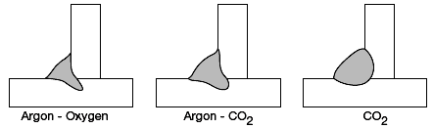
Common Argon + Helium Blends
75% Argon + 25% Helium — this binary blend is frequently applied to improve the penetration profile for aluminum, copper, and nickel applications. The puddle is more fluid than with 100% argon.
75% Helium + 25% Argon — the higher helium content Increases the thermal conductivity and puddle fluidity. The Penetration profile is broad, and it exhibits excellent sidewall penetration.
Relative effect of Oxygen versus CO2 additions to the argon shield

Slide 27
Argon + CO2
The most commonly found binary gas blends are those used for
carbon steel GMAW welding. All four traditional modes of
GMAW metal transfer are used with argon/CO2 binary blends.
They have also enjoyed success in pulsed GMAW applications
on stainless steel where the CO2 does not exceed 4%.
Axial spray transfer requires CO2 contents less than 18%.
Argon/CO2 combinations are preferred where mill scale is an
unavoidable welding condition. As the CO2 percentage increases,
so does the tendency to increase heat input and risk burn through.
Argon/CO2 blends up to 18% CO2 support pulsed spray transfer.
Short-circuiting transfer is a low heat input mode of metal
transfer that can use argon/CO2 combinations. Optimally, these
modes benefit from CO2 levels greater than or equal to 20%.

Slide 28
Common Short-Circuiting Transfer Shielding Gas Blends
75% Argon + 25% CO2 — reduces spatter and improves weld
bead appearance on carbon steel applications.
80% Argon + 20% CO2 — another popular blend, which further
reduces spatter and enhances weld bead appearance on carbon
steel applications.

Slide 29
Common Axial Spray Transfer shielding gas blends
98% Argon + 2% CO2 — for axial or pulsed spray with stainless
steel electrodes and carbon steel electrodes. This blend has
seen repeated success on high-speed sheet metal applications.
There is excellent puddle fluidity and fast travel speeds
Associated with this shielding gas blend.
95% Argon + 5% CO2 — for pulsed spray with carbon steel
electrodes. The addition of 5% CO2 provides for additional
puddle fluidity, and it lends itself to heavier fabrication than
blends with 2% CO2.
92% Argon + 8% CO2 — for both axial and pulsed spray
applications on carbon steel. Higher energy in axial spray
transfer increases puddle fluidity.

Slide 30
90% Argon + 10% CO2 — for either axial spray or GMAW-P
applications on carbon steel. The penetration is broader and it
reduces the depth of the finger-like penetration exhibited by
argon + oxygen mixes.
85% Argon + 15% CO2 — the higher CO2 level in axial or
pulsed spray transfer increases sidewall fusion on sheet metal or plate thickness material. Generally produces improved toe
wetting on carbon steel with low levels of mill scale.
In GMAW-S, short circuiting transfer, the lower CO2 level translates to less heat for welding parts with less risk of burn through.
82% Argon + 18% CO2 — the effective limit for axial spray with CO2.

Slide 31
Argon + Oxygen
Argon/oxygen blends attain axial spray transfer at lower currents
than argon/CO2 blends. The droplet sizes are smaller, and the
weld pool is more fluid. The use of argon + oxygen has
historically been associated with high travel speed welding on
thin materials. Both stainless steel and carbon steel benefit from
the use of argon/oxygen blends.
99% Argon + 1% Oxygen — used for stainless steel applications.
The use of oxygen as an arc stabilizer enhances the fine droplet
transfer and maintains the puddle fluidity for this gas blend.
Stainless steel welds will appear gray because of the oxidizing
effect on the weld pool.

Slide 32
98% Argon + 2% Oxygen — used as a shielding gas for either carbon or stainless steel applications. The earliest use of argon/oxygen blends for axial spray transfer on carbon steel employed 2% oxygen level. It is typically applied to applications that require high travel speed on sheet metal. Applied with either axial spray or pulsed spray transfer modes. Stainless deposits are dull gray in appearance. This blend is often used when superior mechanical properties are required from low alloy carbon steel electrodes.
95% Argon + 5% Oxygen — general purpose axial spray or pulsed spray transfer shielding gas applied to heavier sections of carbon steel. The base material is usually required to be free of contaminants with a low level of mill scale.

Slide 33
Common Ternary Gas Shielding Blends
90% Helium + 7.5% Argon + 2.5% CO2 — is the most popular
of the short-circuiting blends for stainless steel applications. The
high thermal conductivity of helium provides a flat bead shape
and excellent fusion. This blend has also been adapted for use
in pulsed spray transfer applications, but it is limited to stainless
or nickel base materials greater than 1.6 mm thick. It is
associated with high travel speeds on stainless steel applications.
55% Helium + 42.5% Argon + 2.5% CO2 — although less
popular than the 90% helium mix discussed above, this blend
features a cooler arc for pulsed spray transfer. It also lends itself
very well to the short-circuiting mode of metal transfer for
stainless and nickel alloy applications. The lower helium
concentration permits its use with axial spray transfer.

Slide 34
38% Helium + 65% Argon + 7% CO2 — this ternary blend is for use with short-circuiting transfer on mild and low alloy steel applications. It can also be used on pipe for open root welding. The high thermal conductivity broadens the penetration profile and reduces the tendency to cold lap.
90% Argon + 8% CO2 + 2% Oxygen — this ternary mix is applied to short-circuiting, pulsed spray, and axial spray modes of metal transfer on carbon steel applications. The high inert gas component reduces spatter.

Slide 35
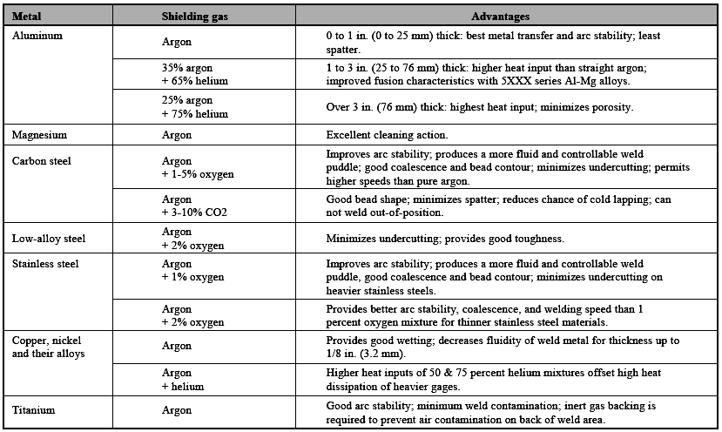
Selection of gases for GMAW with spray transfer

Slide 36
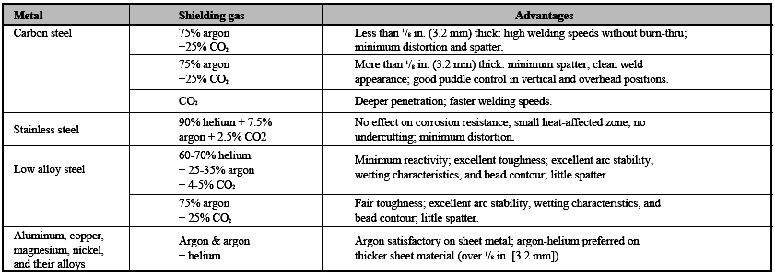
Selection of gases for GMAW with short circuiting transfer.

Slide 37
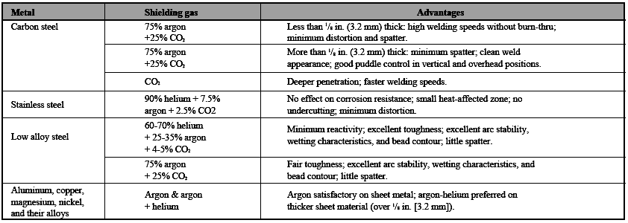
Selection of gases for GMAW with short circuiting transfer.

Slide 38
GMAW of Carbon and Low Alloy Steels

Slide 39
Selecting Carbon and Low Alloy Steel Electrodes
Selecting the proper filler metal for use with GMAW is similar to the
process that must be employed when determining the applicable
electrode for any welding process:
• The electrode must deposit welds that will have the mechanical and chemical properties needed for the proper performance of the welded connection.
• The electrode must be suitable to address the unique circumstances associated with the particular application.
• The electrode must meet the welder’s expectations in terms of arc action and puddle control.
• The selected electrode should result in the total overall lowest cost of welding. This is not to say that the lowest cost electrode will always lead to the total overall lowest cost; in many cases, a higher purchase priced electrode will result in decreased overall costs.

Slide 40
A Two Component System
GMAW is a two-component welding process, in terms of the
consumables that will be used: both a gas and an electrode are
required. The electrode selection process cannot be made
separate from consideration of the type of shielding gas that will
be used. The most efficient means of selection of the proper
filler metal for GMAW is to consider electrode/gas combinations
when making comparisons. For example, a more expensive
shielding gas, with a less expensive electrode, may or may not
be more economical than a low cost gas and more expensive
electrode. Thus, the electrode/gas combination must be
considered.

Slide 41
The gas selection can have an effect on mechanical properties as well. Changes in shielding gas may increase or decrease
Charpy V-Notch properties of the deposit, for example. The effect of shielding gas on weld properties is more significant for the higher strength, and more alloyed, filler metals.
Electrode Diameter
As with other processes, the diameter of the electrode used with
GMAW is an important decision. Considerations have to be made for the various welding positions, the material thickness and the selected mode of metal transfer.
Production Conditions
The type of conditions that are encountered in production welding influences the electrode selection. A key factor is material cleanliness: the more oxide on the base metal surface, the higher the need for deoxidizers in the electrode.

Slide 42
Troubleshooting

Slide 43
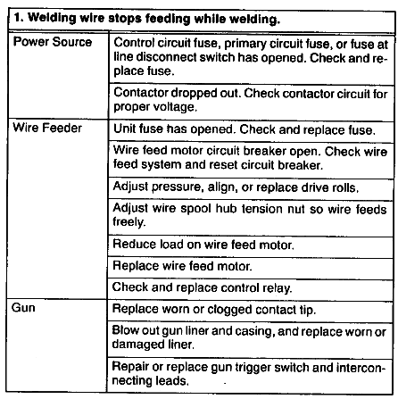

Slide 44
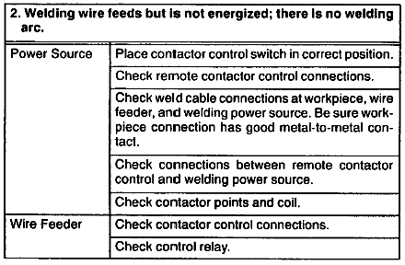

Slide 45
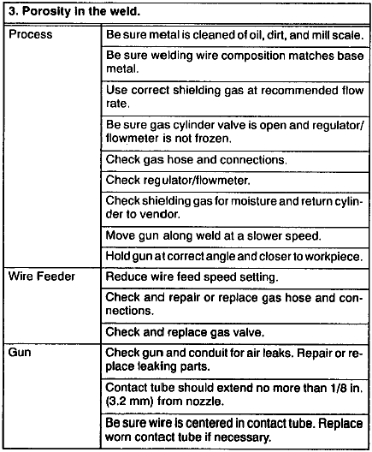

Slide 46

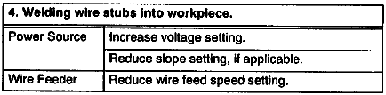
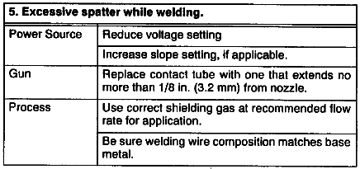

Slide 47
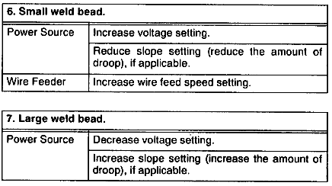

Slide 48

END

